Slide 1
Baird 2021 Global Industrial Conference
November 10, 2021
Notes:
Good Afternoon
My name is Ted Harris, President, CEO, and Chairman of the Board of Balchem Corporation
With me today is Martin Bengtsson, Balchem’s CFO
I am looking forward to telling you a little about our special company

Slide 2
Safe Harbor Statement
During the course of this presentation, management may make forward-looking statements regarding financial performance and future events.
We will attempt to identify these statements by use of words such as expect, believe, anticipate, intend, and other words that denote future events. You should understand that, even though our forward-looking statements are based on assumptions we believe are reasonable when made, they are still subject to uncertainties that could cause actual results to differ materially from those in the forward-looking statements.
We caution you to consider the important risk and other factors as set forth in the forward-looking statements section and in Item 1A risk factors in our Annual Reports on Form 10-K as filed with the U.S. Securities and Exchange Commission that could cause actual results to differ from those in the forward-looking statements as contained in this presentation.
Forward-looking statements made herein are summaries of previous public disclosures, do not represent revised guidance, and we do not undertake to revise or update them from the date or dates of previous disclosure.
In the case of any presentation delivered during the company’s prescribed black-out periods, there will be no discussion or questions addressed regarding the current quarter’s expected performance.
Notes:
I would like to start by reminding you that we may make forward looking statements during today’s presentation
And that actual results may vary

Slide 3
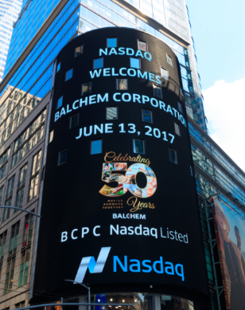
Balchem Corporation
Balchem develops, manufactures, and markets specialty ingredients that help
make the world a healthier place
Highlights
NASDAQ: BCPC
Founded in 1967
Headquarters: New Hampton, NY
Approximately 1,300 Employees
21 Manufacturing Sites:
17 in North America
3 in Europe
1 in Asia
5 Technology Centers
2020 Revenues of $704M
2020 Adj. EBITDA of $174M or 25% of sales
2020 Cash Flow From Operations of $150M
A Global Health And Nutrition Focused Company With A 50+ Year History
Notes:
Balchem was founded in 1967 and we celebrated our 50th anniversary in 2017
but have really transformed over the last six years, almost doubling in size
And outperforming the Russell 2000 by approximately 20%
We are a specialty ingredient manufacturer for health and nutrition markets; particularly Human and Animal Health and Nutrition
We are a $5B+ market cap company,
Traded on the NASDAQ
We finished 2020 with $704M in sales and a 25% Adj. EBITDA margin
21 plants, with 5 R&D sites in the U.S., Europe, and now Asia

Slide 4
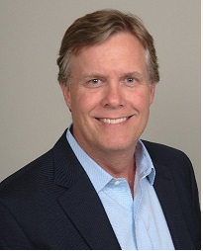
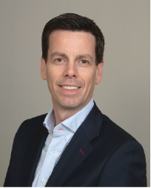
Leadership
Ted Harris, Chairman and CEO
Joined Balchem in May 2015
Prior to Balchem was a Senior VP of Ashland Inc. where he held a series of senior leadership roles over 10+ years
Independent director and member of the Board of Directors of Pentair plc.
MBA from Harvard University and bachelor’s degree from Lehigh University in chemical engineering
Martin Bengtsson, CFO
Joined Balchem in February 2019
Prior to Balchem had a 15-year career at Honeywell and most recently was CFO for the $11B Performance Materials & Technologies segment
Bachelor’s degree from Northwestern University in economics and began career as Senior Auditor for Deloitte
Executive Leadership
Notes:
I have been with Balchem over 6 years with 34 years in the specialty ingredients and chemicals markets
And Martin is into his third year with the company after a storied 15 year career at Honeywell in several of their specialty materials and chemicals businesses

Slide 5
Balchem at a Glance
OTHER
SPECIALTY PRODUCTS
99%
Nutrition & Health
(% of FY 2020 sales)
HUMAN NUTRITION & HEALTH
ANIMAL NUTRITION & HEALTH
99% Of Revenues Focused On Nutrition & Health
Notes:
We manage our company through 3 market facing business segments
Human Nutrition and Health
Animal Nutrition and Health
and Specialty Products
84% of our revenue comes from Human and Animal Nutrition & Health
and 15% from Specialty Products

Slide 6
Segment Overview
Segment | Markets Served | Solutions
Human Nutrition & Health | Nutritional Supplements Food and Beverage Infant & Toddler Formula Organic Cereal | Microencapsulation Choline Chelated Minerals Powder, Flavor, & Cereal Systems
Animal Nutrition & Health | Dairy Poultry and Swine Companion Animal Aquaculture | Microencapsulation Choline Chelated Minerals Amino Acids and Other Nutrients
Specialty Products | Medical Device Sterilization Nut and Spice Fumigation Plant Nutrition | Chelated Minerals Ethylene Oxide and Propylene Oxide re-packaging
Other | Oil and Gas Fracking Other Industrial Markets | Choline Choline Derivatives
99%
Nutrition & Health
(% of sales)
Leveraging Solutions Across Segments
Notes:
You can see the markets served in each segment and that 3 core technologies, or solutions, are common to varying degrees across our four segments:
Micro-encapsulation (world leader)
The essential nutrient Choline (world leader)
And chelated minerals (where we are the world leader in Human Nutrition and we have a growing position in Animal Nutrition and Plant Nutrition)

Slide 7
Vision and Mission
Our vision is clear; to make the world a healthier place
Our mission is to build a global nutrition and health company delivering trusted, innovative, and science based solutions to our customers
Committed To Building A Global Nutrition And Health Company
Notes:
At Balchem, we unite as a team behind the higher purpose
To make the world a healthier place
And we are focused on:
Building a global Nutrition and Health Company
by delivering:
Trusted
Innovative
and science-based solutions to our customers

Slide 8
Strategic Focus
Strengthening Positions in Attractive, Growing Markets
Building scale, adding adjacent capabilities, expanding market and geographic reach, broadening our portfolio of solutions, investing in new science, enabling market awareness
Driving Organic Growth
Creating new demand through innovation, market penetration, new product launches, geographic expansion, and expanding addressable markets
Augmenting Organic Growth through Strategic Acquisitions
Maintaining a Healthy Margin Profile, Strong Cash Flow, and Solid Balance Sheet to Execute
Staying Focused
Notes:
Our strategic priorities are:
Building larger, stronger, better positioned Human and Animal Nutrition and Health businesses
Driving growth, both organically and inorganically within these businesses
For example, within the Human Nutrition and Health business, we feel like we are just in our infancy as Choline and Mineral nutrition awareness grows, based at least in part on the clear health benefits of these important nutrients
And within Animal Nutrition and Health, we are similarly in an early stage of growth, where we have significant market penetration opportunity ahead of us
And accomplishing all of that while maintaining our healthy margin profile and continuing to generate strong cash flows

Slide 9
Balchem Growth Platforms
Human Nutrition & Health
Animal Nutrition & Health
Leveraging Synergies Across Segment FDA RDI for Choline and Expanded Choline Awareness / Science Mineral Nutrition Systems for Nutritional Beverages Curemark® Delivery System Geographic Expansion and M&A
ReaShure® Penetration NRC Recommendation on Choline Rumen Protected Nutrients for Dairy Next Generation By-pass and Release Technology Pet and Aquaculture Expansion Geographic Expansion and M&A
HUMAN NUTRITION & HEALTH
ANIMAL NUTRITION & HEALTH
Growth over 5 years
SPECIALTY PRODUCTS
INDUSTRIAL PRODUCTS
Specialty Products
M&A
Growth Platforms
Market Growth
Leveraging our Global Performance Gases Platform Plant Micronutrients New Applications New Products Geographic Expansion
Multiple Platforms To Drive Growth
Notes:
In 2020, our Human Nutrition and Health segment generated sales of $400M with an EBITDA margin of approximately 24.3%
Our growth platforms are:
Leveraging Synergies Across the Segment
The FDA’s Recent Recommended Daily Intake recommendation for Choline and Expanded Choline Awareness / Science
Mineral Nutrition where we have the leading brand of chelated minerals to meet growing consumer needs
Systems for Nutritional Beverages
The Curemark® Delivery System where we have a unique delivery system for a drug in development to treat autism
And Geographic Expansion & M&A
In 2020, our Animal Nutrition and Health segment generated sales of $192M with an EBITDA margin of approximately 20.4%
Our growth platforms are:
Further market penetration of our flagship ReaShure® brand, from approximately 40% penetration of the dairy cows in the United States to 50% or more
And from less than 5% in Europe to 20% or more
Additional Rumen Protected Nutrients for Dairy
Like our Next Generation AminoShure XM product that we just launched which is a rumen protected methionine product
Expansion within the Companion Animal and Aquaculture Markets
and Geographic Expansion & M&A
In 2020, our Specialty Products segment generated sales of $104M with an EBITDA margin of approximately 37.5%
Our growth platforms are:
Within the Performance Gases business
Delivering on the synergies associated with the recent Chemogas Acquisition
And building a global franchise
And within the Plant Nutrition business
Growing through
New Applications such as row crops
New Products such as an organic chelated potassium
And Geographic Expansion

Slide 10
COVID-19 Pandemic Response Update
Sixteen months into the pandemic, our focus remains on employee safety first, keeping our manufacturing sites operational, and satisfying customer needs. To date;
all of our manufacturing sites are operating at near normal conditions,
our research and development teams continue to advance our innovation efforts in our laboratories,
and our historical full-time office-based employees are effectively carrying on their responsibilities and functions in a hybrid office/remote manner
Sales challenged during the pandemic by weaker demand in food services and medical device sterilization are starting to slowly return to more normal levels
Demand favorably impacted by changes in consumer behaviors during the pandemic; retail food products, pet food, functional technologies aiding food preservation needs, and immunity strengthening minerals and nutrients, have remained relatively strong
Raw material costs and availability as well as supply chain and logistics disruptions are increasingly, and significantly, impacting costs as we manage through the global macroeconomic uncertainties
COVID-19 Pandemic Still Having An Impact
Notes:
With regards to Covid-19, the last 16 months have certainly been some of the most challenging we have ever experienced.
We have worked very hard to keep our employees safe, our factories operating, and all of our processes functioning so that we could keep our customers fully serviced.
I am extremely pleased with the response efforts of the Balchem team and ultimately our ability to deliver in 2020, and so far in 2021 despite the pandemic challenges
As we have shared earlier, we knew that sales would likely be challenged by weaker demand in some areas such as food services and medical device sterilization due to fewer elective surgeries. But we are gradually seeing the return to more normal levels and that is encouraging.
At the same time, some of the demand positively impacted such as retail food products and immunity boosting minerals and nutrients have remained strong so far.
The biggest impact we are seeing at the moment is really around the raw material inflation and disruptions in global logistics. Costs have increased dramatically in a very short time and it is very hard to predict right now if and when these significant price increases while return to more normal levels.
While we are doing everything we can to pass this through to our customers through price increases, it is hard to keep up when prices move so quickly in a short period of time and it could take some time to fully catch up and alleviate the margin pressure.

Slide 11
Market Outlook – Pre, During, Post Covid-19 Pandemic
Market dynamics for key markets served by Balchem:
 | External Metrics | Pre Pandemic | During Pandemic | Post Pandemic | Comments
Food and Beverage | GDP Food and Bev. Growth |  |  |  | Positive and negative demand drivers largely offsetting and foodservice slowly recovering
Supplements | Vitamin/mineral growth |  |  |  | Higher demand for “immunity boosting” vitamins and minerals likely to continue to some extent
Dairy | Dairy consumption Dairy prices |  |  |  | Volatile milk prices create uncertainty, but overall remain at relatively healthy levels.
Protein | Protein consumption Broiler sales |  |  |  | Short term supply chain issues largely addressed by protein processors
Agriculture / Plant Nutrition | Net Farm Income Crop prices |  |  |  | Positive and negative demand drivers largely offsetting
Medical Device | GDP Medical Device Sales |  |  |  | “Pent-up” demand from postponement of elective surgeries gradually recovering
Energy | GDP Rig count |  |  |  | With rising demand for oil post-pandemic there is some modest increase in demand
Post pandemic market dynamics will largely recover to pre-pandemic outlook, but we remain cautious
Notes:
With the outbreak of Covid-19, and all the uncertainty and volatility that has followed, we have refreshed this market outlook slide based on our current expectations.
Highlighted here are ”Pre”, “During”, and “Post” Covid-19 expectations based on the dynamics we are seeing in the markets we serve.
Food and Beverage – While we have seen lower demand for Foodservice during the pandemic, we have seen somewhat offsetting demand pick up in other areas like retail and preservation and we expect Food service to slowly recover and we don’t see any longer term disruption to our business model
Supplements – we have experienced strong demand during the Pandemic as people focus on immune boosting minerals and vitamins and we expect this heightened awareness to provide some benefit also Post Covid.
Dairy & Protein – While prices have been volatile during the pandemic and supply chains have been disrupted, the impact was relatively short lived and we view the underlying demand fundamentals supporting a healthy market going forward
Agriculture / Plant Nutrition – The impact has been fairly muted and we don’t see any longer term impacts to the overall market dynamics
Medical Device – With fewer elective surgeries being performed during the pandemic, the demand for medical device sterilization has decreased. While there is clearly some pent up demand, we are cautious in terms of how long it will take for people to want to return to the hospitals and we think there may be some extended delay in this recovery.
Energy – This part of our portfolio has really become insignificant at this point in time with the reduced fracking activity, and with expected demand for oil to be lower for the foreseeable future, we are not betting on any recovery in this space.
Taking a step back, we believe that in aggregate, the post-pandemic market dynamics will largely be in-line with our pre-pandemic outlook, but we are cautious given the higher degree of uncertainty that prevails at the moment.

Slide 12
Q3 2021 Financial Summary
Sales
($M)
 13.0%
Adj. EBITDA
($M)
 8.8%
Adj. Net Earnings
($M)
 11.3%
Adj. EPS
($/share)
 10.9%
Strong growth in all three segments
Higher sales prices to recapture raw material inflation
Driven by Sales growth
Raw material inflation and logistics and distribution disruptions key headwinds, partially offset by pricing
Driven by Sales growth
Slightly higher tax rate in Q3 ’21 compared to Q3 ’20
Growth in earnings
Small increase in diluted outstanding shares (+0.4%)
Strong Quarter In Challenging Environment
Notes:
In terms of our most recent quarter’s performance, being the 3rd quarter of 2021:
Overall, we had a very strong quarter:
Consolidated sales were up 13% year over year led by strong growth in all three segments
We also delivered record Adjusted EBITDA, up 8.8% from the prior year quarter. We are experiencing significant Raw Material inflation as well as continued disruption in the global logistics and distribution channels, but we have been able to partially offset this with increased pricing as well as improved manufacturing efficiencies.
And Adjusted Net earnings of $30.0 million, were up 11.3% year over year, driven by the higher sales offset partially by a slightly higher tax rate in Q321 of 23.6% compared to 23.4% in prior year. The lower rate in the prior year was primarily due to higher R&D tax credits
So overall, a strong quarter and one that showed our resilience and ability to deliver also in very challenging environments

Slide 13
Historical Financials
SALES ($M)
ADJ. EBITDA ($M)
ADJ. NET EARNINGS ($M)
ADJ. EPS ($/share)
Consistent Performance Due To Resilient Business Model
Notes:
Over the last 6 years, ending 2020, we have delivered consistent performance and growth as you can see from these charts showing:
Sales
Adj. EBITDA
Adj. Net Earnings
And Adj. EPS
And 2020 was our 10th consecutive year of sales & Adjusted EPS growth
Further, you can see that we have continued this trend in 2021, where YTD Sales are up 12%, and Adj. EBITDA is up 10%.

Slide 14
Segment Financials
SALES ($M)
ADJ. EBITDA ($M)
Other
SP
ANH
HNH
Other
SP
ANH
HNH
Resilient Business Models
Notes:
Each of our segments has contributed nicely to our growth over this time frame as well
HNH CAGR 2017-2020 of 8.2%
ANH CAGR 2017-2020 of 6.8%
SP CAGR 2017-2020 of 12.2%
Balchem CAGR 2017-2020 of 5.8%
HNH CAGR 2015-2020 of 7.5%
ANH CAGR 2015-2020 of 3.0%
SP CAGR 2015-2020 of 13.8%
Balchem CAGR 2015-2020 of 5.0%
Maybe don’t say: Our Other and Unallocated sales in industrial markets have been significantly volatile over the last five years and has negatively impacted overall growth

Slide 15
Capital Allocation Strategy and M&A
Capital Allocation Strategy
Annual Cash Flow ($M) and Debt Leverage Ratio
Prioritize organic growth investments
Augment organic growth with targeted M&A
Pay down debt
Continue to pay and grow dividend
Stock buy-backs for anti-dilution
Six acquisitions since 2016
Focus on core Nutrition & Health
Adding geographic reach, adjacent products/technologies, and market consolidation
0.0 Debt Leverage
M&A
Maintain Disciplined Capital Allocation Strategy
Notes:
Our Capital Allocation strategy remains unchanged
We continue to prioritize organic and inorganic growth
While maintaining a healthy balance sheet and a sensible debt leverage ratio
As you can see from the chart that we have done over the last 5 or 6 years

Slide 16
Recent Acquisitions
 |  | Rationale | Key Offering
Zumbro River Brand December 2019 |  | Market consolidation and expanded product offering | High protein extrusion and agglomeration
Chemogas May 2019 |  | Adds leadership position in Europe to already existing U.S. leadership | Ethylene Oxide re-packaging and distribution
Bioscreen August 2018 |  | Microencapsulation manufacturing in Europe | Microencapsulation and Fermentation
IFP June 2017 |  | Market consolidation and processing technology and capability | Microencapsulation and Agglomeration
Chol-Mix March 2017 |  | Geographic reach into Eastern Europe | Dry Choline Chloride
Albion February 2016 |  | Adjacent product offering | Chelated Magnesium, Iron, Calcium, Zinc, and others
Augmenting Organic Growth With Targeted Acquisitions Close To Core
Notes:
We have made six bolt-on acquisitions over the last four years to add:
adjacent product offerings to our portfolio
geographic expansion
And to create scale and drive industry consolidation
And All of these acquisitions have been very close to our core, and have helped to build:
larger, stronger, better positioned businesses within Balchem

Slide 17
Free Cash Flow Conversion
Free Cash Flow as % of Non-GAAP Net Earnings
Solid Free Cash Flow Conversion, Turning Profits Into Cash
Notes:
Additionally, cash conversion is an important focus for us
Over the last few years, we have averaged a Free Cash Flow as a % of Non-GAAP Net Income of around 100%, showing our ability to turn profits into cash
We have maintained this strong performance over the years and certainly plan to continue to do so,
baring any significant capital expenditures, that for example, we invested in, in 2015

Slide 18
Dividends
Annual double-digit dividend growth for the last decade
Consistency in execution
($/share)
Consistent Dividend Policy
Notes:
We are also maintaining a consistent dividend approach and we have grown our dividend double-digits for the last decade.
And we just announced here in December another year of double-digit dividend growth, taking the dividend from 52 to 58 cents, an 11.5% increase YoY

Slide 19
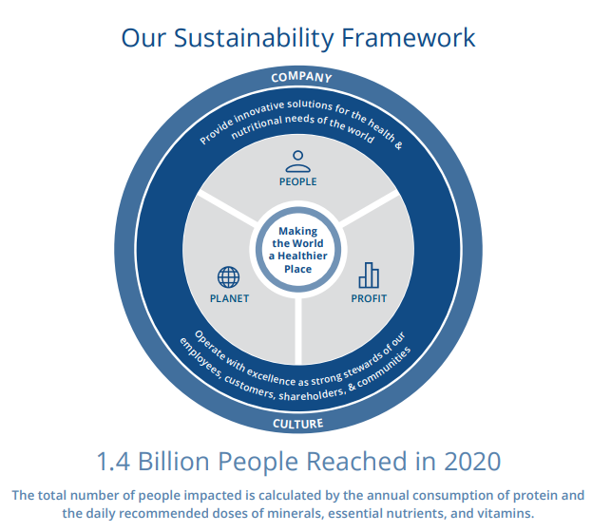
Our Sustainability Framework
Every day, Balchem is delivering trusted solutions that enhance health and well-being through science.
The two objectives of our sustainability strategy directly support our vision of making the world a healthier place:
providing innovative solutions for the health and nutritional needs of the world
and operating with excellence as strong stewards of our employees, customers, shareholders, and communities
One of our proud accomplishments is Balchem’s impact on 1.4 billion people each year.
Making The World A Healthier Place
Notes:
With regards to Environmental, Social, and Corporate Governance, we have taken the opportunity to consolidate all the great work that we have been doing for many years, into a consolidated report that we have published for the third year in April 2021.
Our two primary objectives of our sustainability strategy are to
provide solutions for the Health and Nutrition needs of the world
and act as strong stewards of all our stakeholders

Slide 20
Our 2030 ESG Goals
EMISSIONS REDUCTION
Balchem commits to reduce our GHG emissions by
25%
OPPORTUNITY EXAMPLES
Process improvements in spray drying by increasing feed solids
Reduce drying with product design (e.g., ReaShure®-XC)
Major consumer efficiency improvements (e.g., modernized boilers)
Use of renewable energy sources (e.g., Grimbergen solar project)
WATER
CONSERVATION
Balchem commits to reduce our global water use by
25%
OPPORTUNITY EXAMPLES
Eliminate “once through” cooling water systems in Marano and Verona sites
Reduce water use in clean in place (CIP) systems with improved utilization and change to dry clean options
Condensate recovery systems
Committed To 2030 Goals
10
Notes:
Of particular note in the report, we have, for the first time, published our 2030 goals to:
reduce both greenhouse emissions and
water usage by 25% by that date.
We are very proud of the report and the progress we have been making and I would encourage you to go to Balchem.com to read the report.

Slide 21
Measuring Our Progress
People |  | Planet |  | Profit
 | 1.4 billion – number of people reached per year |  | 10.8 billion – number of animals reached per year |  | 28.2% – revenue from products developed in the past five years
 | 1.04 – total recordable injury rate (TRIR) |  | 3.75 GJ/ton – energy intensity (GJ of energy per ton of product produced) 76,802 (CO₂e metric tons) – scope 1 and scope 2 greenhouse gas emissions (CO₂e metric tons) |  | $703.6M – total revenue
 | 26% – hourly employee turnover 7% – salary employee turnover |  | 12.57 CBM – water intensity (cubic meters of water withdrawal per metric ton of product produced) 0.06% – water withdrawal from regions with high or extremely high baseline water stress |  | $174.2M – adjusted EBITDA
 | 77% males, 23% females – employee diversity |  | 99% – hazardous waste reused or recycled 75% – hazardous material suppliers audited in the last 3 years |  | $84.6M – GAAP net earnings $2.60 – GAAP earnings per share
 | 75% – R&D focused on health and nutrition |  | 100% – of palm oil sourced certified through RSPO 37% – raw materials from renewable resources |  | 138% – free cash flow conversion
 | 100% – manufacturing sites with local community engagement efforts |  | 0 – product recalls |  | 15.7% – 5-year total shareholder return (TSR) vs Russell 2000 Index
People, Planet, Profit
Notes:
We report out around three pillars:
People, Planet, Profit
We are proud of our accomplishments to date and look forward to sharing updates with you as we progress our initiatives to make the world a Healthier Place

Slide 22
What Makes Balchem Unique?
Proven ability to grow in all economic conditions
Steady and thoughtful capital allocation
Continued innovation
Consolidated position in Choline
Premium branded products and patent portfolio
EPA Registrations for EO and PO
Proven Track Record Of Growth
Protected Positions
Delivery Systems
Microencapsulation
Systems (Powders, Flavors)
Chelation
Choline
Organic growth platforms and earnings power
Market Penetration
New Product Development
Geographic expansion
Strategic M&A
Curemark®
Technologies
Future Upside
Well Positioned For The Future
Notes:
Overall, we believe Balchem in a unique company with attractive characteristics
We have a track record dating more than 50+ years and continue to innovate in the industry
We have carved out protected positions in our markets and stay ahead of our competition
We are able to leverage a number of key technologies across our segments and drive synergies
And we have a tremendous future upside potential from to grow organically both through market penetration and geographic expansion with our existing and new innovative products

Slide 23
Summary / Wrap Up
Leading Positions in Attractive Markets
Creating New Demand Through Innovation
Delivering Healthy Margins
Generating Cash Flow from Operations Available for Reinvestment
Proven Track Record
Reasons To Invest
Notes:
In summary, there are 5 primary investment highlights that I hope you took away with from this presentation.
We have Leading Positions in Attractive Markets
We are Creating New Demand Through Innovation and Driving Growth Across our Segments
We Deliver Healthy Margins
We are Generating Strong Cash Flow from Operations Available for Reinvestment
And we have a Proven Track Record of Growth

Slide 24
Notes:
Thank you very much for your time today
and more importantly, thank you for your interest in our company

Slide 25
Appendix

Slide 26
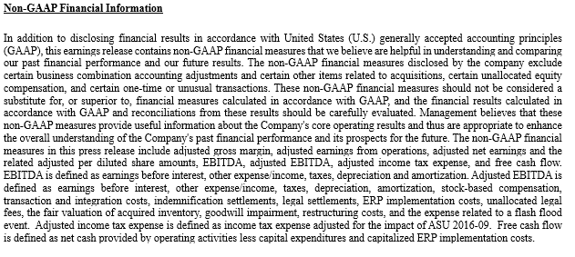
Non-GAAP Financial Information

Slide 27
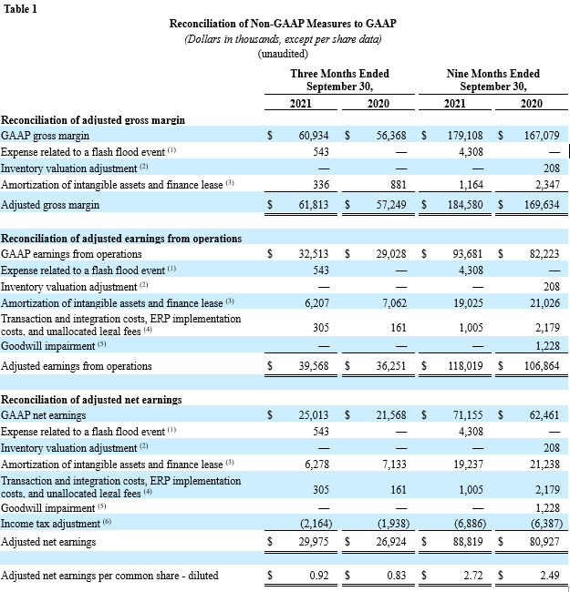
Non-GAAP Financial Information - Continued

Slide 28
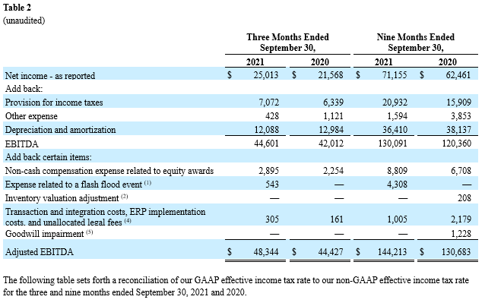
Non-GAAP Financial Information - Continued

Slide 29
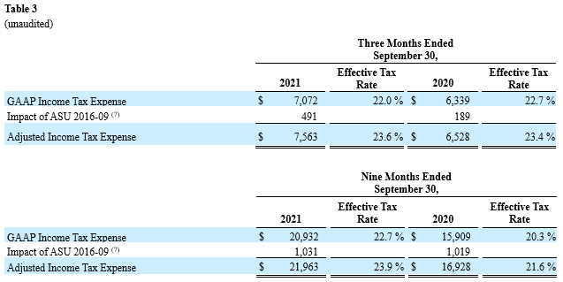
Non-GAAP Financial Information - Continued

Slide 30
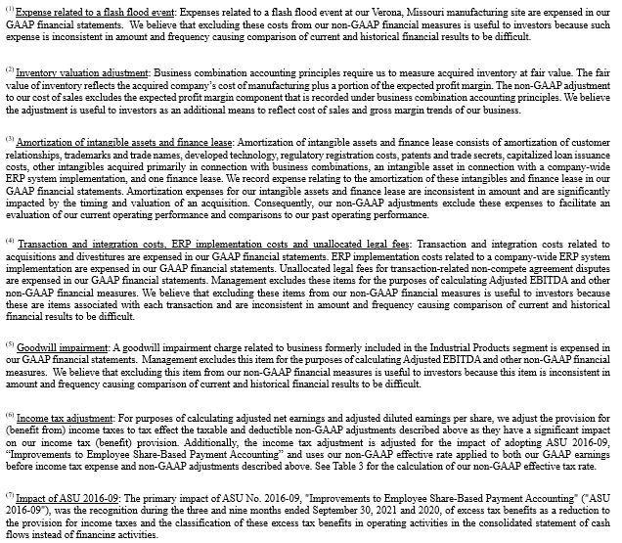
Non-GAAP Financial Information - Continued

